Slide 1



Who am I
Muhammad Daniyal Saleem
Microsoft Student Partner
Microsoft Community Trainer
HTML5 Developer Evangelist
Trainer | AUC Technologies
Currently Working On
HTML5
Windows Phone 8.1
Cross-Platform Development

Slide 2

Help Your Business Grow Faster

Slide 3
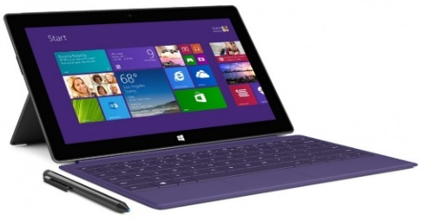
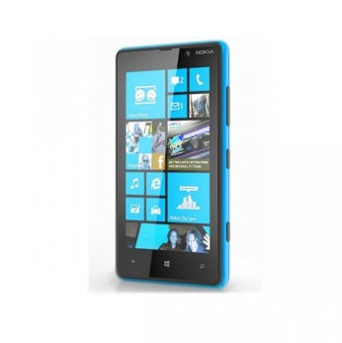







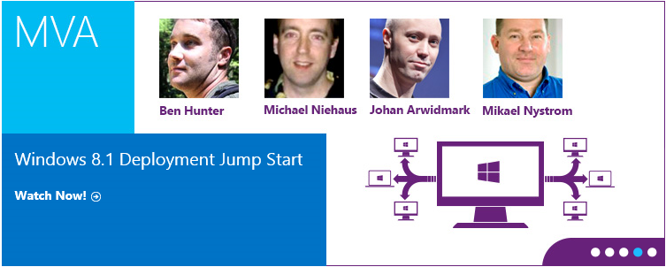

Programs & Offers
Technical Skill
Development
Microsoft Student Partner
Microsoft BizSpark
Internships
Microsoft
Virtual Academy
Startup Incubation

Slide 4
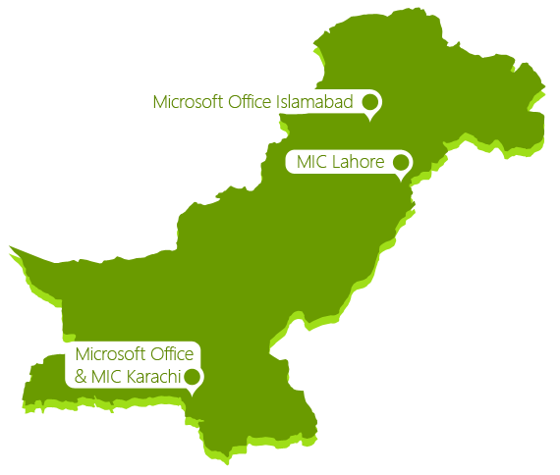
Pakistan IT Echo System Facts
Population
Area
180 Million
796,096
Sq/km
25 Companies with
Universities and Campuses
IT Graduates/year
100+
156
12 k
Developers
7 Companies with
Professional Developers
IT Companies
300+
70,000+
1700
Developers
2 Leading Companies
IT Professionals
Start Ups
700+
65,000+
350+
Developers

Slide 5

Imagine Cup
Pakistan National Winners 2014

Slide 6

What we will cover today ?
{{Agenda}}
{{HTML5}}
Q & A
<HTML5>
{Win.JS} (Windows Phone 8.1);
{User Experience(UX)}
MCSD Exams

Slide 7


Slide 8
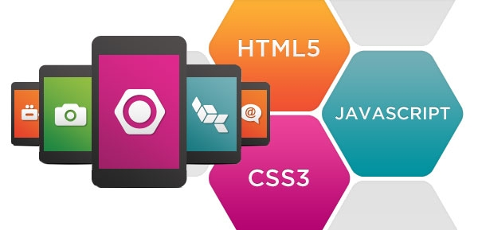
+
+
HTML5 ~=
CSS
JS
HTML

Slide 9
Rough Timeline of Web Technologies
2000
XHTML 1
1991
HTML
2002
Tableless Web Design
1994
HTML 2
2005
AJAX
+
JavaScript
1996
CSS1
1997
HTML 4
2009
HTML 5
1998
CSS2
feature complete HTML5
2011
HTML5 – final
specification
2022

Slide 10

HTML 5

Slide 11




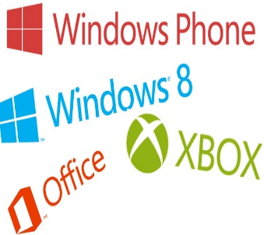

HTML 5
WHAT : Next generation HTML5
WHO : W3C, IETF
WHEN : 2004, 2008, 2012 and 2022
2022 → Is that a typo?
All vendors support it ! (Is that true?)

Slide 12

Structure of Web Application

Slide 13
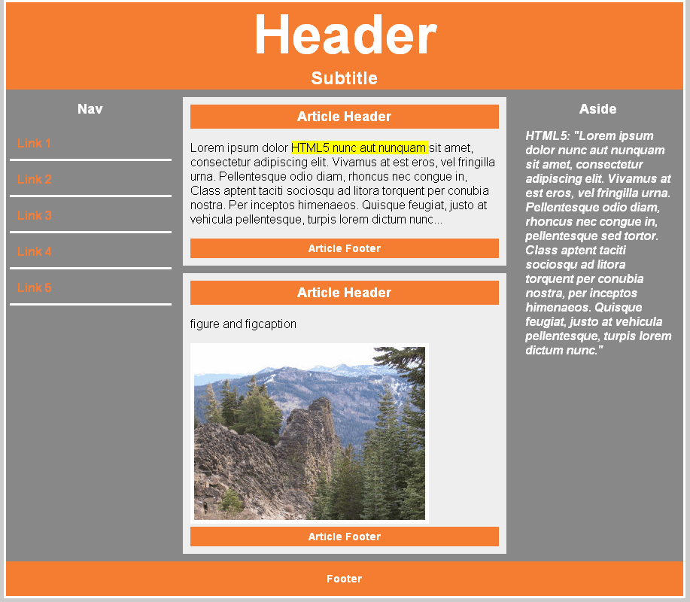
New Layout Structure
Better layout structure | new structural elements
<section>
<header>
<nav>
<article>
<aside>
<footer>

Slide 14

Mobile Application

Slide 15


Slide 16
Trend of Mobile Apps in Future
80% of all mobile apps will use HTML5 by 2015 | 60% HTML5 mobile web browsers by 2013

Slide 17
Programming languages on mobile platforms
What Some Understand :
Objective C (iOS)
C#, XAML (Windows Phone)
Java (Android)
Qt (C++) (Symbian, Maemo)
What everybody understands:
HTML
JavaScript
CSS

Slide 18
What’s new in WinJS? Windows Phone and the road ahead
Daniyal Saleem
Win.Js Developer
Notes:
Thanks for coming to today’s session.
My name is Paul Gusmorino and I work on the developer platform in the operating systems group.
I’m excited to be here on behalf of the whole team back in Redmond to get to talk with you all about what’s new in WinJS.
And as you saw announced in the keynote this morning, there have been some interesting developments on this front… ☺
As a quick show of hands…
Any web developers… currently write web sites or web apps?
Anyone building Windows store apps today?
Anyone using WinJS?
Anyone building Phone apps today?
Great. This session should have stuff for all of you whether you are new to WinJS or not, and whether you are new to Phone or not.

Slide 19
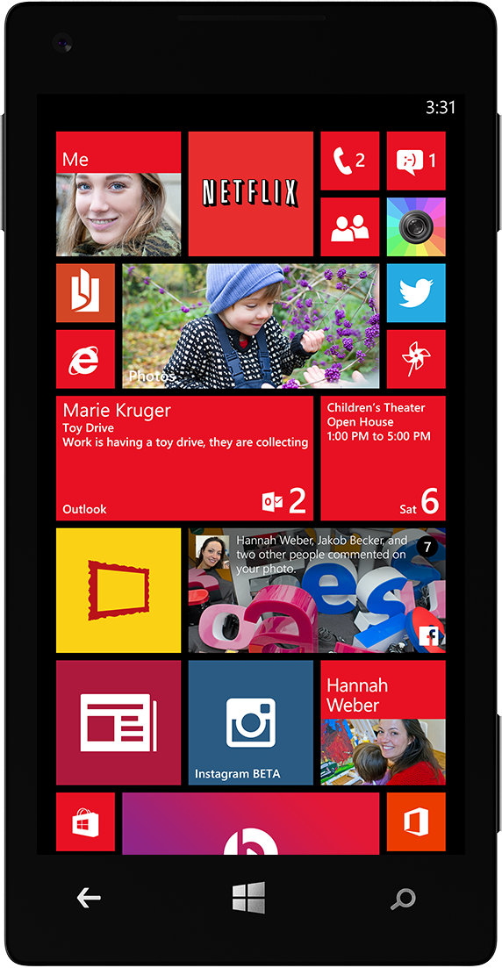
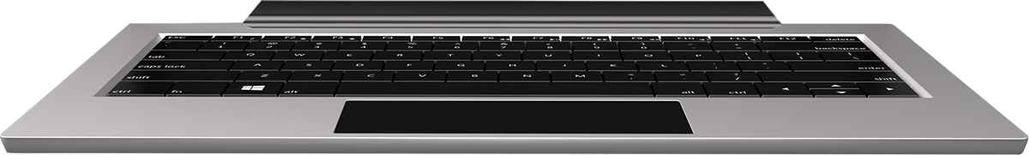
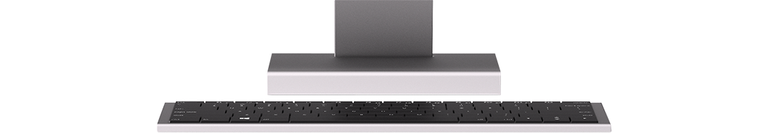

WinJS today
WinJS 2.0
Phone
WinJS 2.1
WinJS
WinJS
WinJS
WinJS
New!
Notes:
You can use WinJS today to make apps for Windows desktops, laptops, tablets, convertibles, etc.

Slide 20
Phone WinJS 2.1 highlights
New controls
Pivot
Improved controls
ListView
AppBar
Jump List
+ more
Building blocks
Animations
User themes
Accessibility
+ more

Slide 21
Getting started and next steps
Microsoft.Phone.WinJS.2.1 available today
Build new Phone 8.1 apps to use it
Port existing Windows 8.1 apps to use it
Get involved on GitHub
Notes:
Get involved: provide feedback on our check-ins, bug fixes, and new features; submit contributions; build and test products using the most up-to-date versions

Slide 22

What is {{UX }} ?
Websites and Web applications have become progressively more complex as our industry’s technologies and methodologies advance. What used to be a one-way static medium has evolved into a very rich and interactive experience.

Slide 23


<User>Experience</User>

Slide 24
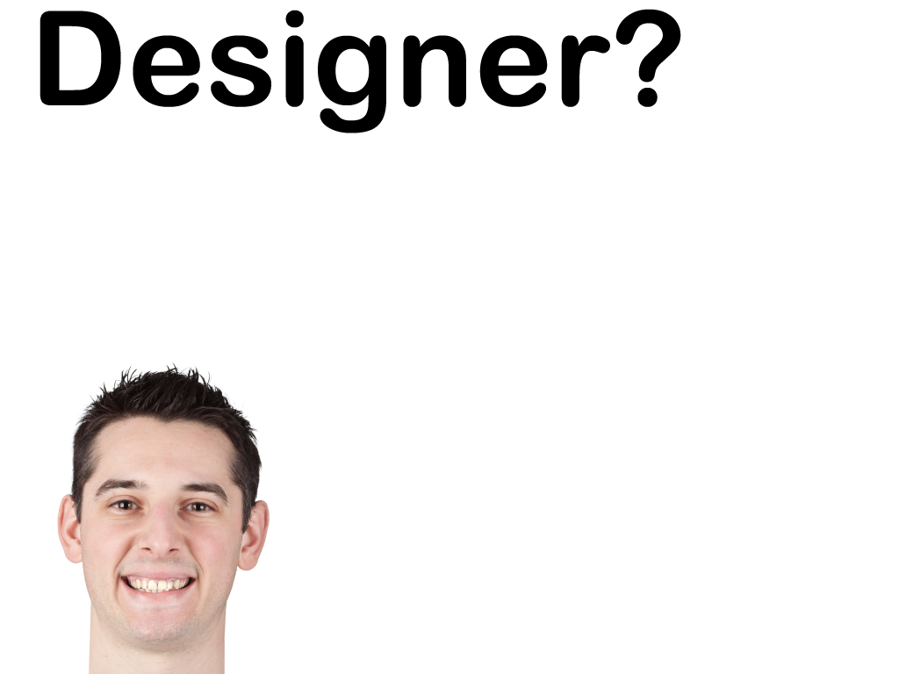

Slide 25


Slide 26


Slide 27
Microsoft Certification

Slide 28


How do you turn that knowledge into certification
Active Directory
Exchange
SQL

Slide 29
Thank you! |
E-mail’s
daniyalsaleemkhan@hotmail.com
daniyalsalemkhan@gmail.com
Contact :
0331-8938411

